Slide 1
Smith Predictor
ME
Universitas Pertamina
2020

Slide 2
Intended Learning Outcomes
Students learn how a mathematical model can benefit control performance of a system.
Students can explain how time delay affects a control system performance.

Slide 3
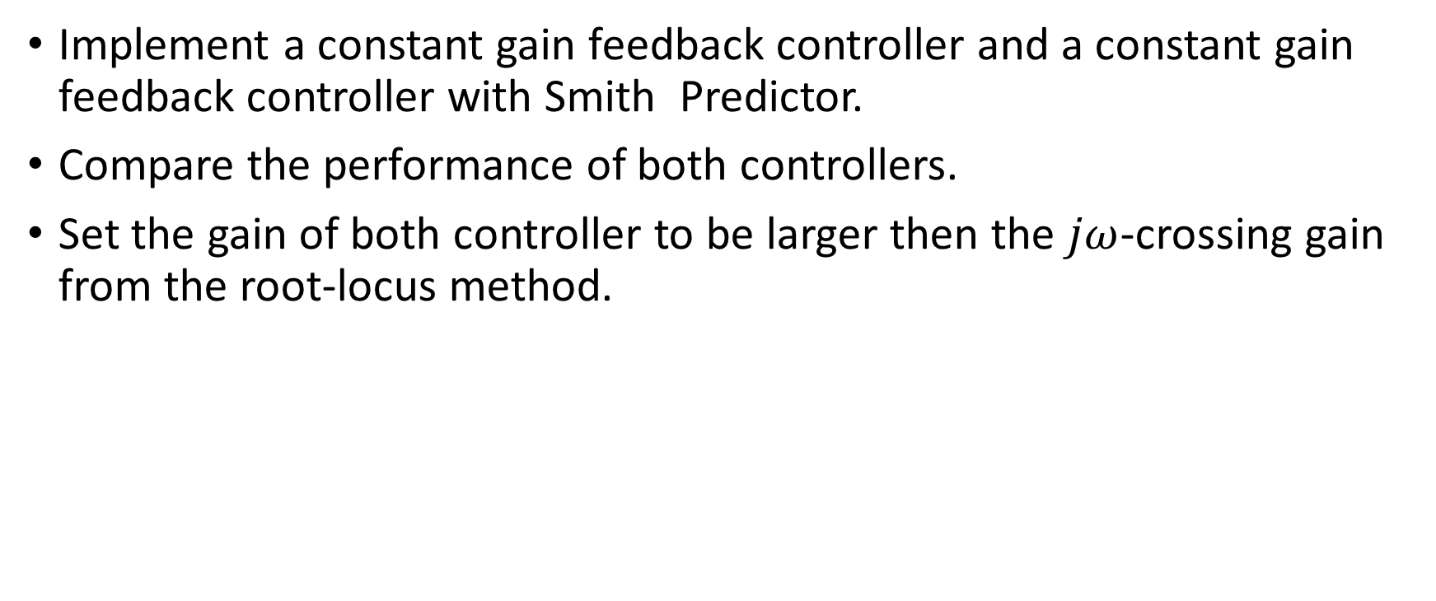
Tasks
Implement a constant gain feedback controller and a constant gain feedback controller with Smith Predictor.
Compare the performance of both controllers.
Set the gain of both controller to be larger then the $jω$-crossing gain from the root-locus method.

Slide 4
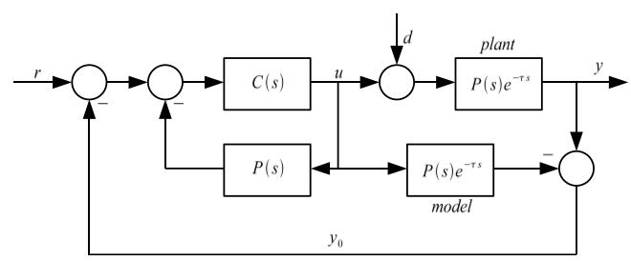
The Classical Smith Predictor [1]
TC Model
TDTC Model

Slide 5
Some results
Less overshoot
Less oscillations

Slide 6
References
[1] O. J. M. Smith, “Closed Control of Loop with Dead Time,” Chemical Engineering Progress 53(5), pp 217-219, 1957

